Slide 1

Module 2- Big Data Infrastructure
Hadoop Ecosystem- Scoop

Slide 2


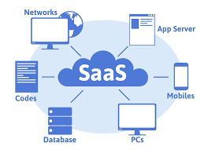
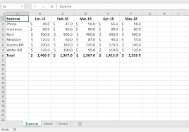


Why Sqoop?
Data Ingestion serves as backbone of any analytics architecture.
As we know transportation of data from assorted sources to a storage medium where it can be accessed, used, and analysed by an organization.
Ingestion can happen in two ways…
Batch
Streaming
To ingest data into Hadoop environment

Slide 3
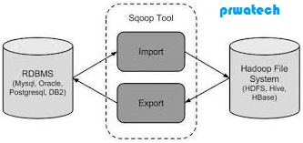
Hadoop Ecosystem
What is Sqoop?
“SQL to Hadoop & Hadoop to SQL”.
Basically it is used to import and export data between MySQL and Hadoop.
Sqoop to import data from a relational database management system (RDBMS) into the Hadoop Distributed File System (HDFS), transform the data in Hadoop, and then export the data back into an RDBMS.
Sqoop can be used with any Java Database Connectivity (JDBC)–compliant database and has been tested on Microsoft SQL Server, PostgresSQL, MySQL, and Oracle.

Slide 4
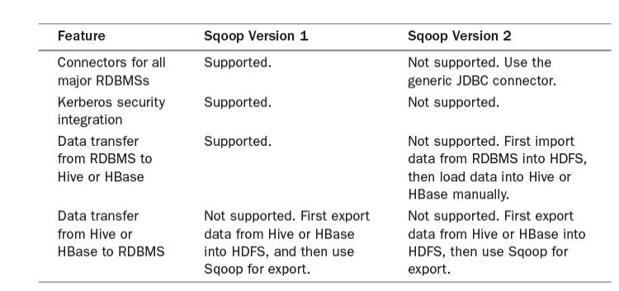
Hadoop Ecosystem
Scoop

Slide 5
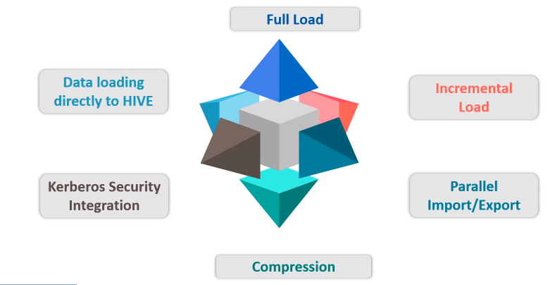
Hadoop Ecosystem
Scoop Features

Slide 6
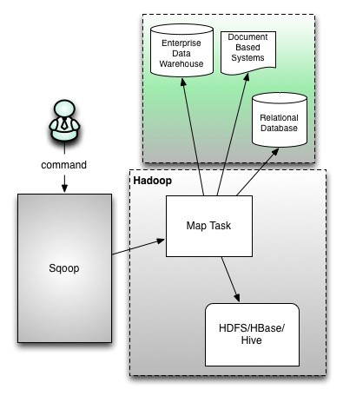
Hadoop Ecosystem
Scoop Architecture
Sqoop provides command line interface to the end users.
Sqoop can also be accessed using Java APIs.
Sqoop command submitted by the end user is parsed by Sqoop and launches Hadoop Map only job .
Sqoop parses the arguments provided in the command line and prepares the Map job.
Map job launch multiple mappers depends on the number defined by user in the command line.
For Sqoop import, each mapper task will be assigned with part of data to be imported based on key defined in the command line. Sqoop distributes the input data among the mappers equally to get high performance.
Then each mapper creates connection with the database using JDBC and fetches the part of data assigned by Sqoop and writes it into HDFS or Hive or HBase based on the option provided in the command line.
https://www.dezyre.com/hadoop-tutorial/hadoop-sqoop-tutorial

Slide 7
Hadoop Ecosystem
Scoop Import
Import each table of the RDBMS in Hadoop and each row of the table will be considered as record in HDFS.
All the records are stored as text data in text files and binary data in sequence or avro files.

Slide 8
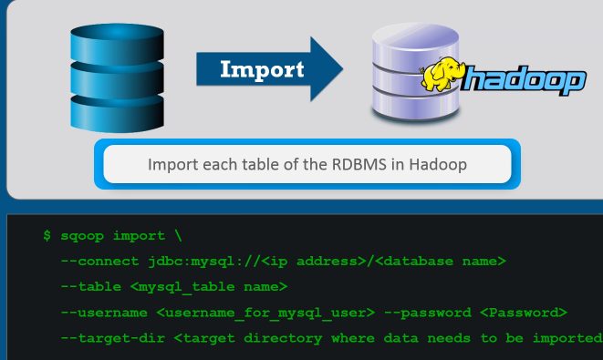
Hadoop Ecosystem
Scoop Commands

Slide 9

Hadoop Ecosystem
Scoop Commands
$ sudo jps

Slide 10
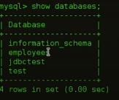
Hadoop Ecosystem
Step 1: MYSQL Terminal
You can create a new database and import the newly created database to the Hadoop.
Here lets use employees database

Slide 11
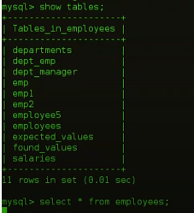
Hadoop Ecosystem
Step 1: MYSQL Terminal

Slide 12
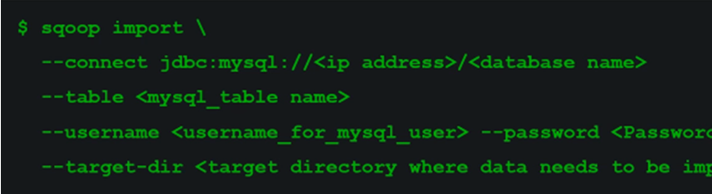
Hadoop Ecosystem
Scoop Terminal
$ sqoop import –connect jdbc : mysql:// local host/employees - -emp 1 - - sudaroli

Slide 13
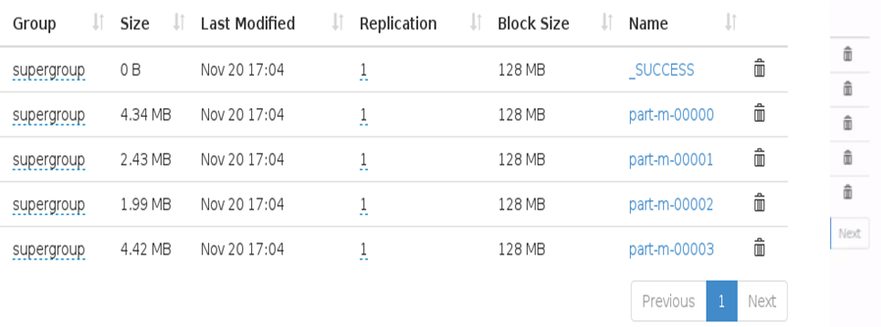
Hadoop Ecosystem
Hadoop

Slide 14
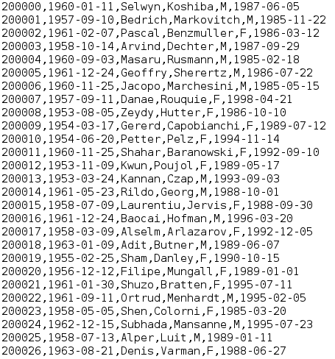
Hadoop Ecosystem
Hadoop

Slide 15
Hadoop Ecosystem
Mentioning of Mapper
$ sqoop import –connect jdbc : mysql:// local host/employees - -table name emp 1 - - user name sudaroli -- m 1 –target –dir/employees

Slide 16
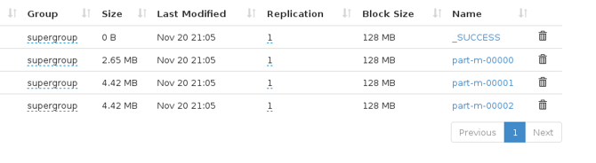
Hadoop Ecosystem
Selecting only the specified attributes
$ sqoop import –connect jdbc : mysql:// local host/employees - -table name emp 1 - - user name sudaroli -- m 3 - - where = “emp_no >20000” –target –dir/new employees

Slide 17
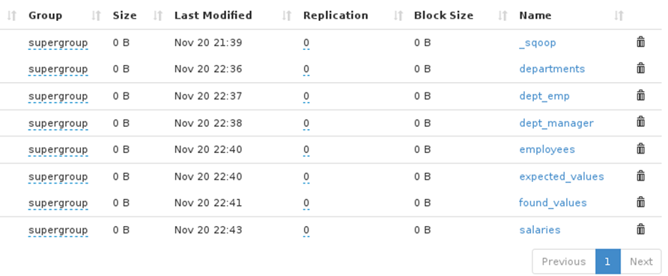
Hadoop Ecosystem
Import all tables in the database
$ sqoop import –all-tables connect jdbc : mysql:// local host/employees - - user name sudaroli

Slide 18
Hadoop Ecosystem
Incremental Load
$ sqoop import –all-tables connect jdbc : mysql:// local host/employees - - user name sudaroli - - table employees - - target - dir / new employees - - incremental append - - check column emp no - - last value 50000

Slide 19
THANK YOU
“WORLD IS ONE BIG DATA PROBLEM”
“TORTURE THE DATA AND IT WILL CONFESS TO ANYTHING”

